Slide 1
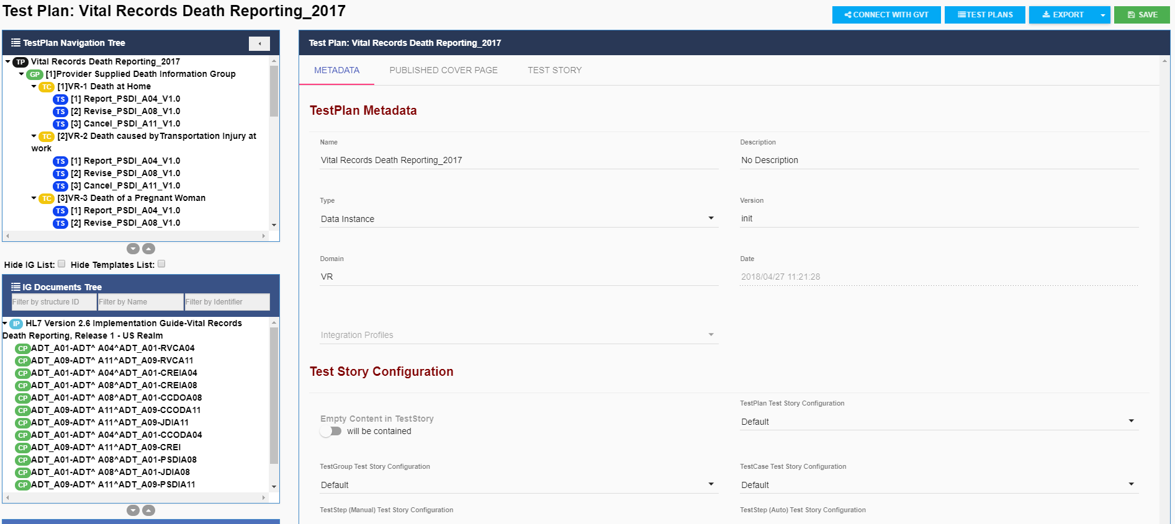
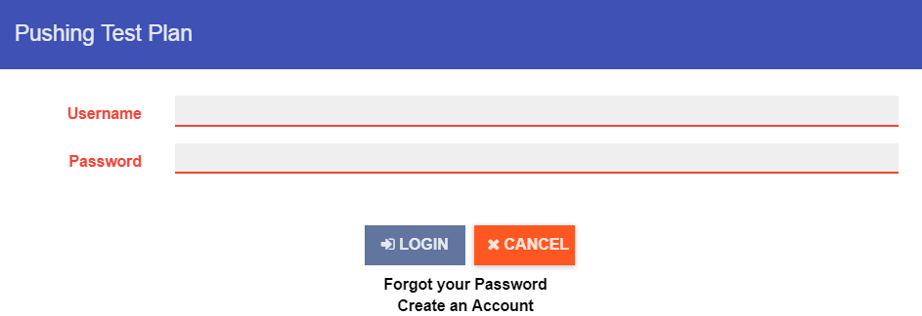
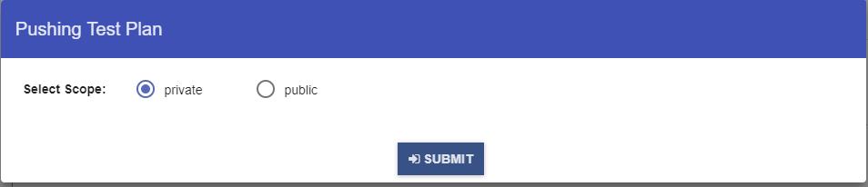
Context-based Test Management: Connecting to GVT from TCAMT
1
In TCAMT, select Test Plans from the main Menu Bar; open a Test Plan, and select Connect with GVT from the Test Plans Menu Bar.
2
Enter GVT Username and Password.
If private Scope is selected, the Test Plan will be available in GVT only to the user who “pushed” the Test Plan from TCAMT and not to all GVT users.
If public Scope is selected, the Test Plan will be available in GVT to all GVT users
3
Select private or public scope on the Pushing Test Plan window and SUBMIT the Test Plan to GVT.

